Slide 1
Inside SCADA Systems
A SCADA (supervisory control and data acquisition) is an automation control system that is used in industries such as energy, oil and gas, water, power, and many more.

Slide 2
Features of scada system
Graphical Representation of Entire System
Continuous Information at Operator Workstations
Automatic Control
Remote Control
Alarming/Paging
Trending/Reporting
Online Monitoring
Alarm notification through SMS/Email
Excel Report Generator (Script Based)

Slide 3
Need of scada
Saves money and time
Remotely Monitor
Less traveling for workers
Reduce manpower needs
Manpower required to look after the plant is reduced as singlePC
Monitors the sections of plant
Increases the production efficiency
To visualize the past data of process variables
To provide Alarms for critical condition
To provide security to SCADA screen to avoid unauthorized user access to graphics data
As SCADA can be connected to Different database like SQL, EXCEL
View and Control Plant-Floor Operations from
Virtually Anywhere through web navigation

Slide 4
Advantages
Remote SCADA users can now view and control real-time plant floor operations data from any device
Available anywhere only internet connection is needed
Multi platform services available on smart phones, tablets, PC etc
Save Maintenance and travel cost in a simple and secure way

Slide 5
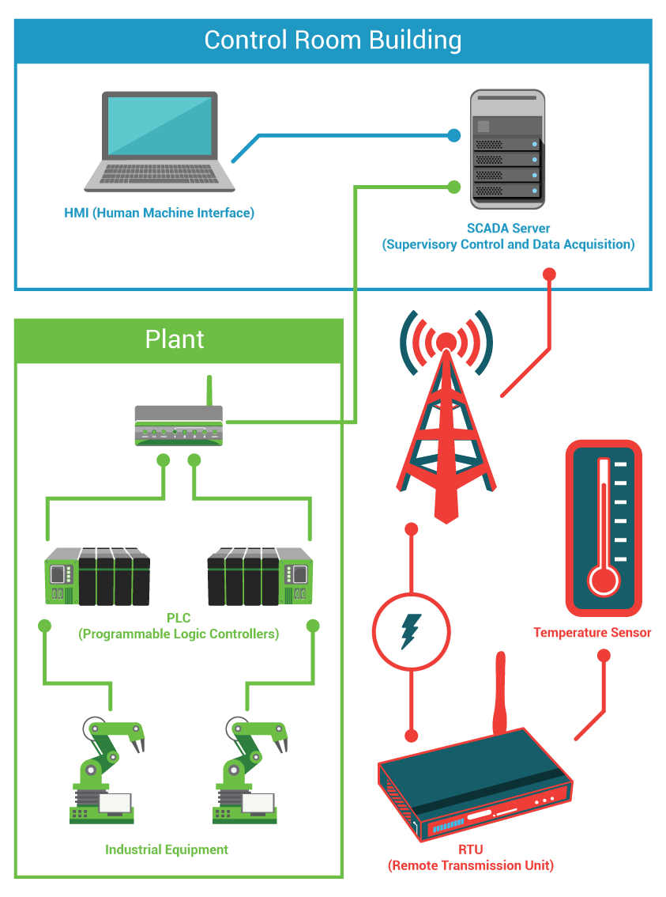
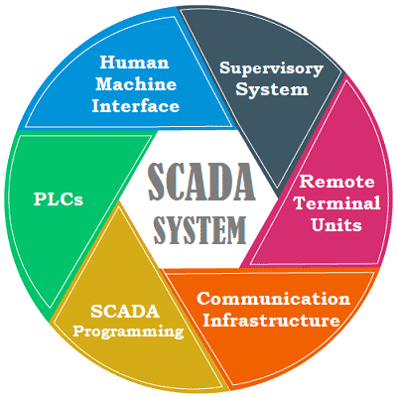
Composing parts of a SCADA system

Slide 6
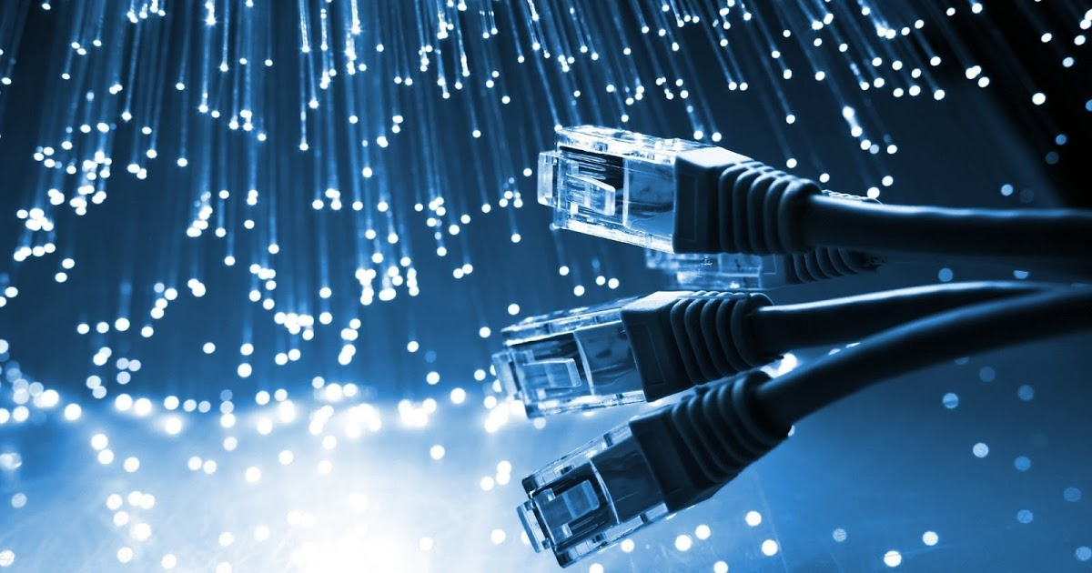
Join the
SCADA system

